Slide 1

Department of Information Technology ABES Engineering College, Ghaziabad, UP
MINI PROJECT PRESENTATION SESSION 2022-23
Team Members:-
Yanshi Gupta (2000320130197)
Shruti Sharma (2000320130160)
Sachin Kumar Singh(2000320130137)

Slide 2


Textractor with AWS
Project Title
+

Slide 3
Contents:
Abstract
Problem Statement
Objectives
Features, Challenges and limitation
Modular structure of the project
Results
Conclusion
Annexures:(a)Code snippets
(b)Certificate(s)
(c)Project Demo Snippets
(d)References

Slide 4
1) Abstract
Documents are a primary tool for record keeping, communication, collaboration, and transactions across many industries, including financial, medical, legal, and real estate.
In our project, we show how you can take advantage of Amazon Textract to automatically extract text and data from scanned documents without any machine learning (ML) experience.

Slide 5
2) Problem Statement
Documents are a primary tool for record keeping, communication, collaboration, and transactions across many industries, including financial, medical, legal, and real estate.
A lot of information is locked in unstructured documents. It usually requires time-consuming and complex processes to enable search and discovery, business process automation, and compliance control for these documents.
So, we are developing an application that could help people to get this complicated data converted into organized, neat and clean data in digital format in the most efficient way by making use of Cloud services.

Slide 6
3) Objective
To develop a stable and Cloud based document scanning application that uses BOTO3 SDK and AWS Textractor OCR engine at the backend.
To make a light application that could be used by devices even with the low specifications.

Slide 7
4) Project Features, Challenges and Limitations

Slide 8
Project: Textractor with AWS
+

Slide 9
What is the project?
In this project we are going to extract text from images by using AWS OCR API with the help of BOTO3 SDK.
We can upload sample text images and can get the text what is written in the image.
Even we can scan different type of data like forms, tables, etc.

Slide 10
Making:
1. Setup:
(a) Python Configuration
(b) BOTO3 Installation
2. Implementation
(a) Making a simple GUI for using the application.
(b) Writing python script for making the functionalities.
(b) Integrating AWS OCR services with BOTO3

Slide 11
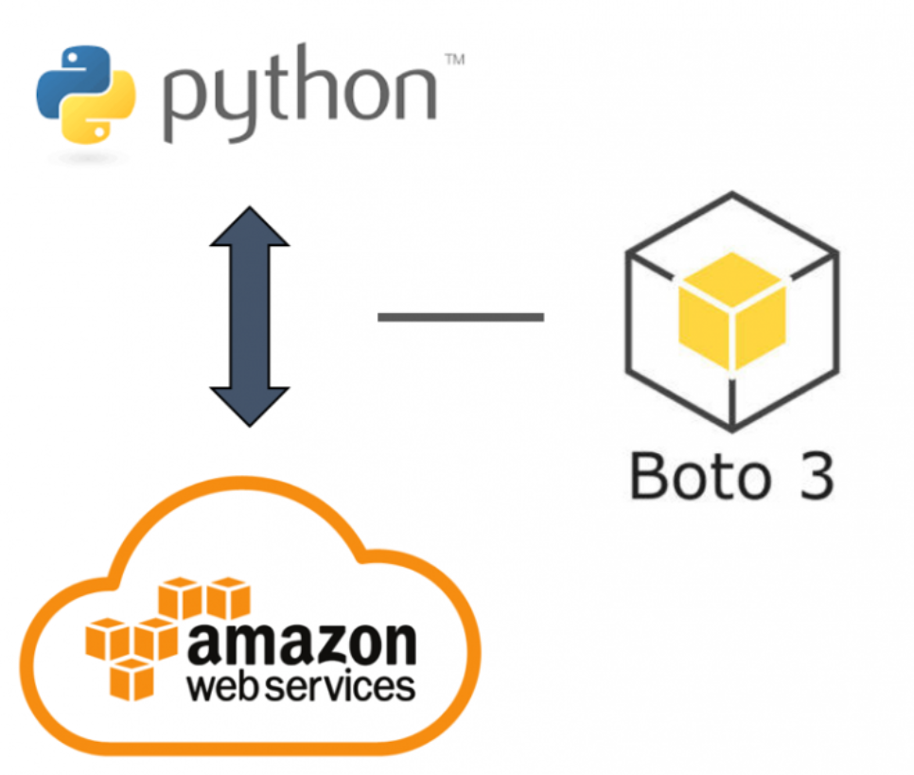
Working

Slide 12
Features
It is a light-weight application as all the processing of images takes place on cloud.
Better are produced by our application that other OCR applications because advanced Textractor service of AWS is used to perform the task.
It also allows different types of data to be scanned like forms, tables, paragraphs, etc.
It produces faster results as all the processing is done by computation power of AWS services.

Slide 13
Challenges & limitations
The major limitation of this project is that the API being used sometimes do not respond to the requests being made to it.
Also, the AWS account that we used was of free tier and that caused problem many times in calling the AWS services.
Also, internet is required for this application to work and that is an issue that can be resolved in future improvements

Slide 14

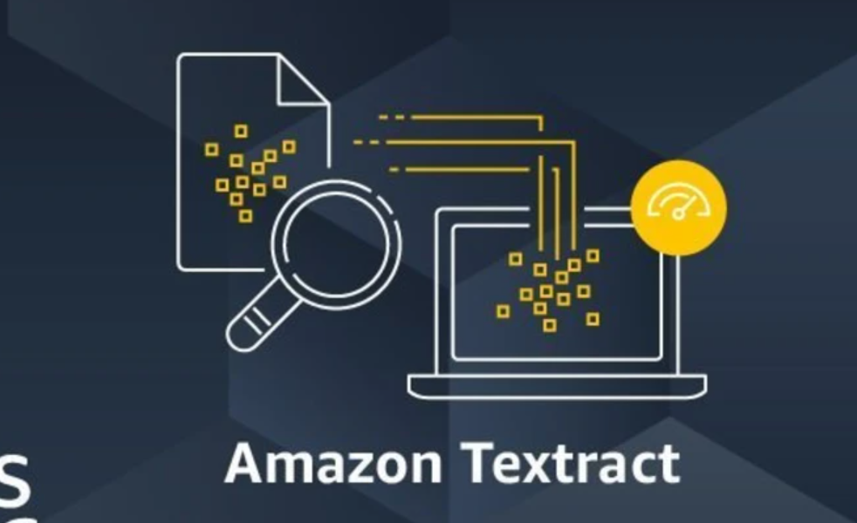
5) Modular Structure of Project:

Slide 15
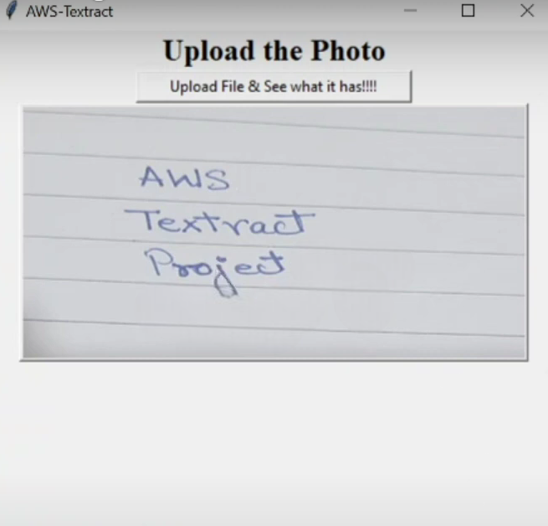
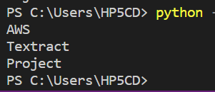
6) Results
Uploading Image
Output

Slide 16
7) Conclusion
This project helped in understanding the concepts of AWS and the various services offered by AWS.
It also helped in getting hands on BOTO3 SDK and its various functionalities.
Also learnt how to integrate AWS services in program with python script.

Slide 17
Future improvement:
To also include the conversion facility from text to pdf.
Also, to scan tables and charts from the documents along with text.
Make it more stable and faster.

Slide 18
7)Annexures

Slide 19
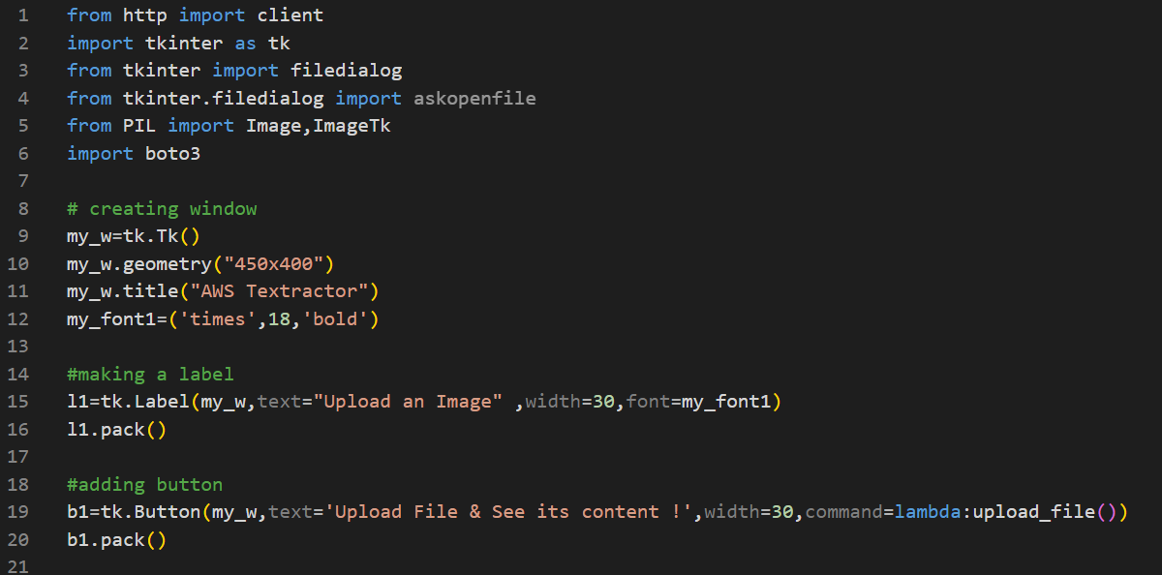
7a) Code Snippets

Slide 20
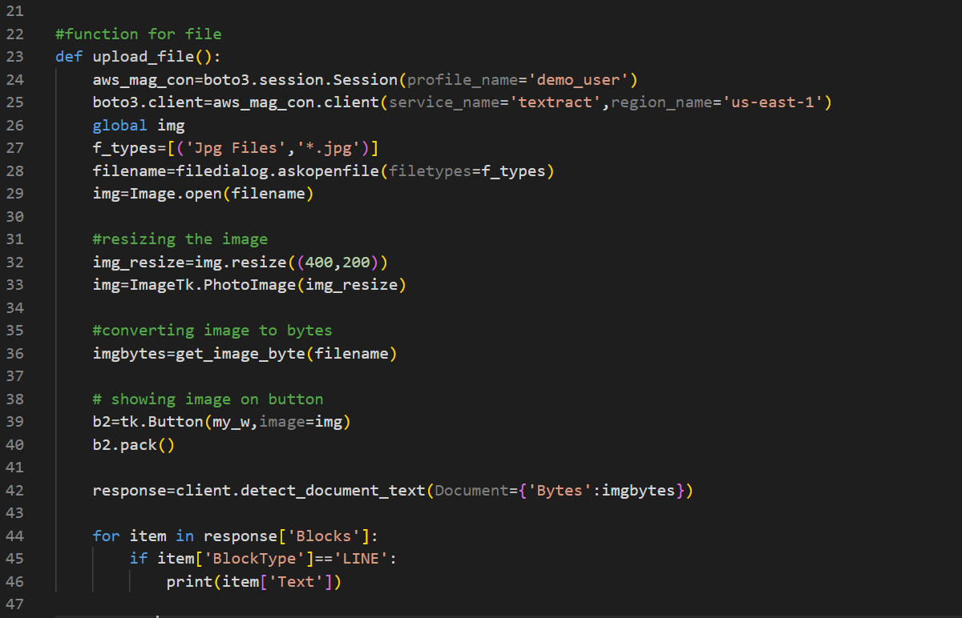
7b) Code Snippets

Slide 21
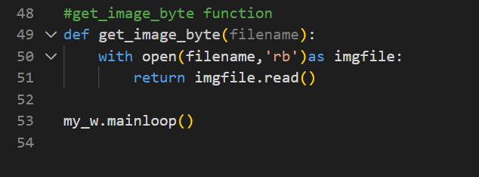
7c) Code Snippets

Slide 22
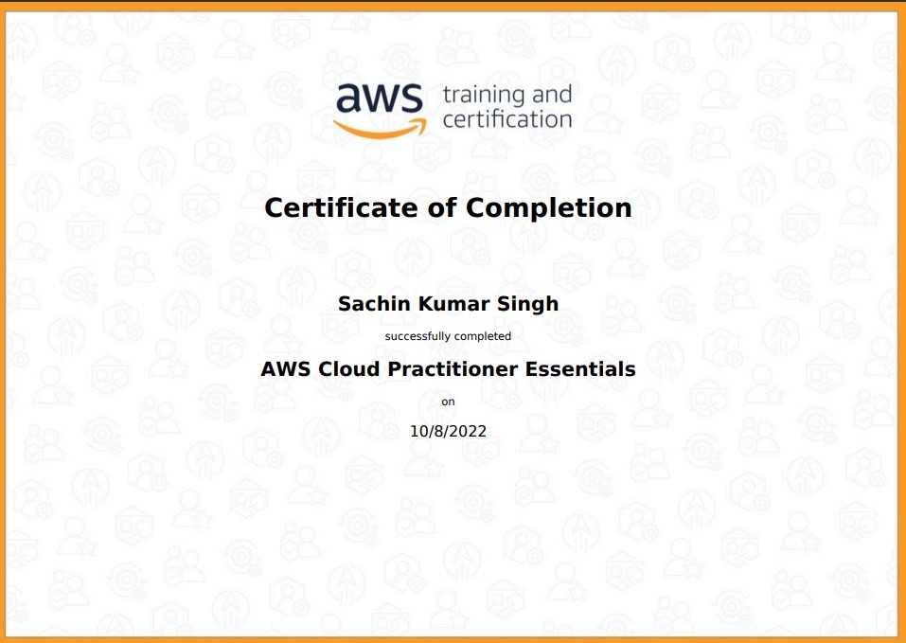
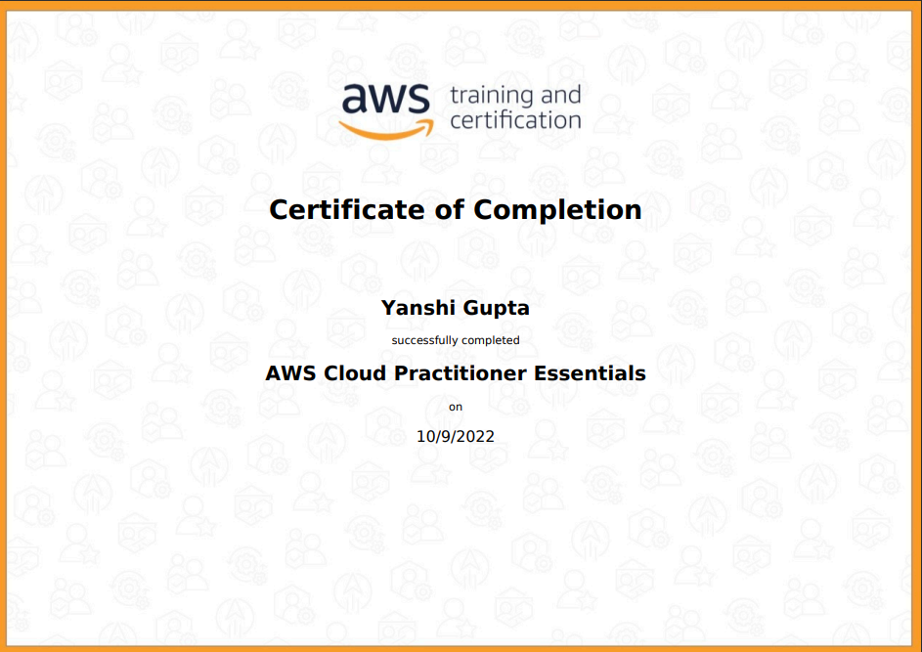
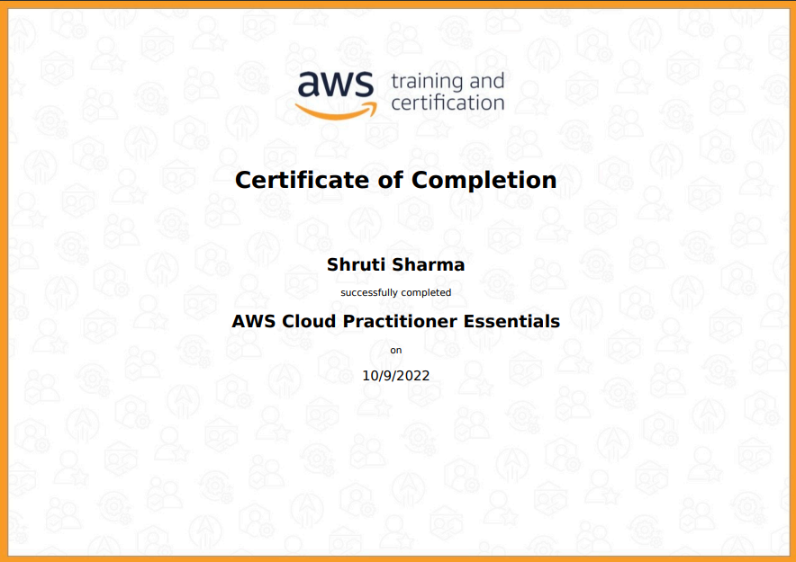
Certificate
Sachin Kumar Singh
Yanshi Gupta
Shruti Sharma

Slide 23
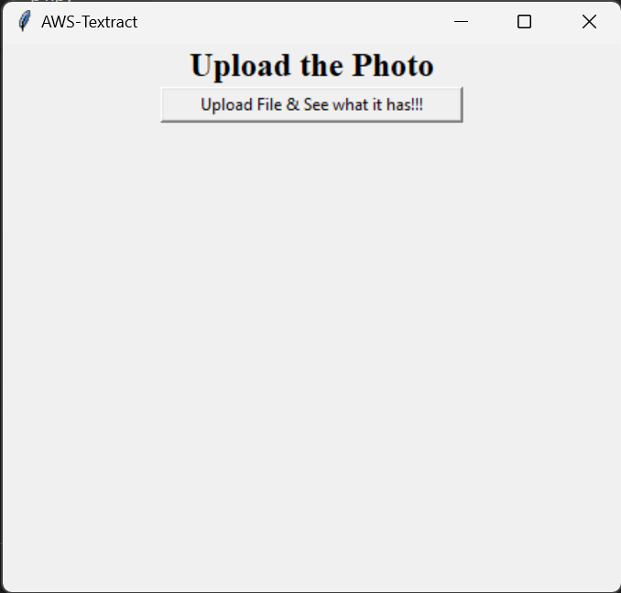
7c) Project Demo: Snippet 1
Starting the program

Slide 24
7c) Project Demo: Snippet 2
Uploading Image
Output

Slide 25
7d) Reference:
Tips and Tricks for Handling Configuration Files in Python
GeeksforGeeks | A computer science portal for geeks

Slide 26
Thank You

